Slide 1
Solid State Chemistry
Solids are a state of matter that are usually highly ordered. The chemical and physical properties of the solid depend on the detail of this ordering.
Elemental carbon can have two different solid phases with differing spatial (position) ordering and vastly different solid properties.

Slide 2
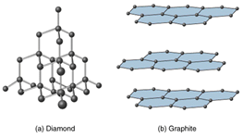
Diamond vs Graphite
Two such allotropes of Carbon are Diamond and Graphite (sp3 and sp2)
In carbon, the bonding in the solid forms is highly directional and dictates the long ranges order. In metals, the bonding is non-directional and often the solid structure is determined by atomic 'packing'.

Slide 3
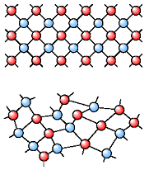
Solids
Crystalline
Amorphous
Crystalline has long range order
Amorphous materials have short range order
203.199.213.48/834/1/Structuresofsolids.ppt

Slide 4
Crystal Type | Particles | Interparticle Forces | Physical Behaviour | Examples
Atomic Molecular Metallic Ionic Network | Atoms Molecules Atoms Positive and negative ions Atoms | Dispersion Dispersion Dipole-dipole H-bonds Metallic bond Ion-ion attraction Covalent | Soft Very low mp Poor thermal and electrical conductors Fairly soft Low to moderate mp Poor thermal and electrical conductors Soft to hard Low to very high mp Mellable and ductile Excellent thermal and electrical conductors Hard and brittle High mp Good thermal and electrical conductors in molten condition Very hard Very high mp Poor thermal and electrical conductors | Group 8A Ne to Rn O₂, P₄, H₂O, Sucrose Na, Cu, Fe NaCl, CaF₂, MgO SiO₂(Quartz) C (Diamond)

Slide 5
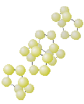


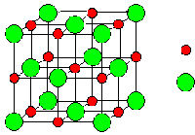
STRUCTURES OF CRYSTALLINE SOLID TYPES
Na⁺
Cl⁻
Molecular Solids
Covalent Solids
Ionic solids
Metallic solids
203.199.213.48/834/1/Structuresofsolids.ppt

Slide 6
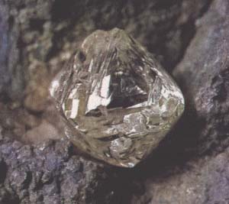
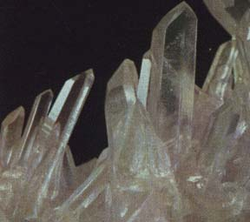
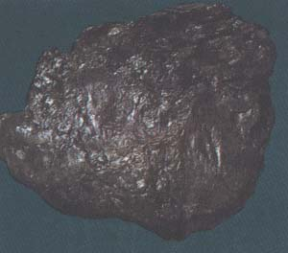
DIAMOND
QUARTZ
GRAPHITE

Slide 7


CRYSTAL STRUCTURE
Crystal structure is the periodic arrangement of atoms in the crystal. Association of each lattice point with a group of atoms(Basis or Motif).
Lattice: Infinite array of points in space, in which each point has identical surroundings to all others.
Space Lattice ≠ Arrangements of atoms
= Lattice of points onto which the atoms are hung
• • •
• • •
• • •
• • •
• • •
• • •
+
=
Space Lattice + Basis = Crystal Structure
Elemental solids (Argon): Basis = single atom.
Polyatomic Elements: Basis = two or four atoms..
Complex organic compounds: Basis = thousands of atoms.

Slide 8
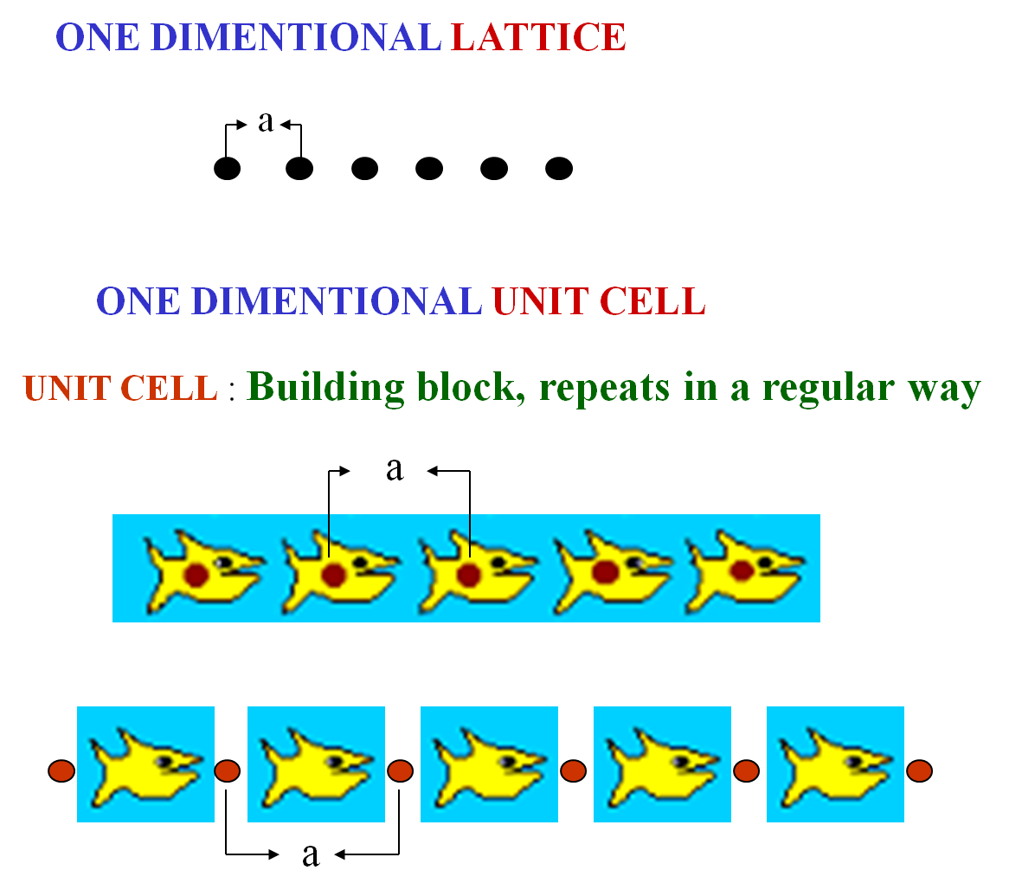
203.199.213.48/834/1/Structuresofsolids.ppt

Slide 9
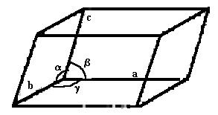
Crystals are made of infinite number of unit cells
Unit cell is the smallest unit of a crystal, which, if repeated, could generate the whole crystal.
A crystal’s unit cell dimensions are defined by six numbers, the lengths of the 3 axes, a, b, and c, and the three interaxial angles, α, β and γ.
203.199.213.48/834/1/Structuresofsolids.ppt

Slide 10

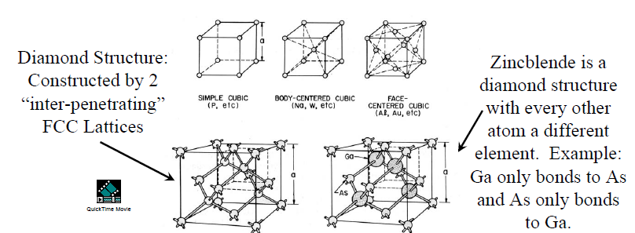

Unit Cell Concept

Slide 11
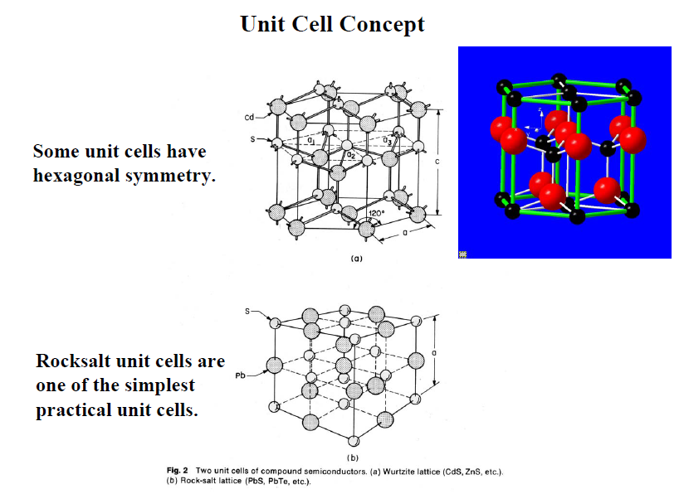
203.199.213.48/834/1/Structuresofsolids.ppt

Slide 12
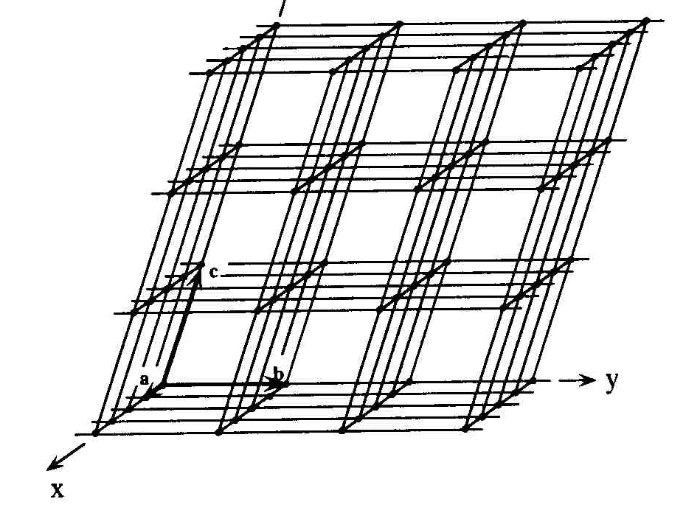
A crystal lattice is a 3-D stack of unit cells
Crystal lattice is an imaginative grid system in three dimensions in which every point (or node) has an environment that is identical to that of any other point or node.
203.199.213.48/834/1/Structuresofsolids.ppt

Slide 13
Miller indices
A Miller index is a series of coprime integers that are inversely proportional to the intercepts of the crystal face or crystallographic planes with the edges of the unit cell.
It describes the orientation of a plane in the 3-D lattice with respect to the axes.
The general form of the Miller index is (h, k, l) where h, k, and l are integers related to the unit cell along the a, b, c crystal axes.
203.199.213.48/834/1/Structuresofsolids.ppt

Slide 14
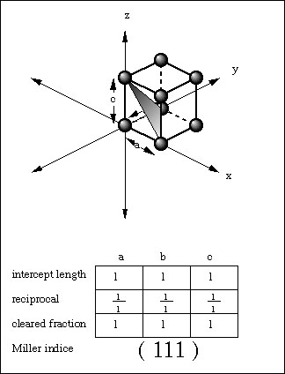
Miller Indices
Rules for determining Miller Indices:
Determine the intercepts of the face along the crystallographic axes, in terms of unit cell dimensions.
2. Take the reciprocals
3. Clear fractions
4. Reduce to lowest terms
An example of the (111) plane (h=1, k=1, l=1) is shown on the right.

Slide 15
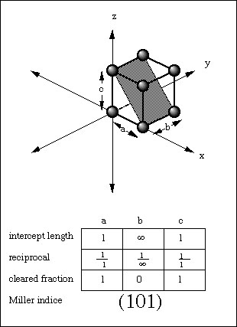
Another example:
In this case the plane intercepts the a axis at one unit length and also the c axis at one unit length. The plane however, never intersects the b axis. In other words, it can be said that the intercept to the b axis is infinity. The intercepts are then designated as 1,infinity,1. The reciprocals are then 1/2, 1/infinity, 1/1. Knowing 1/infinity = 0 then the indices become (101).
203.199.213.48/834/1/Structuresofsolids.ppt

Slide 16
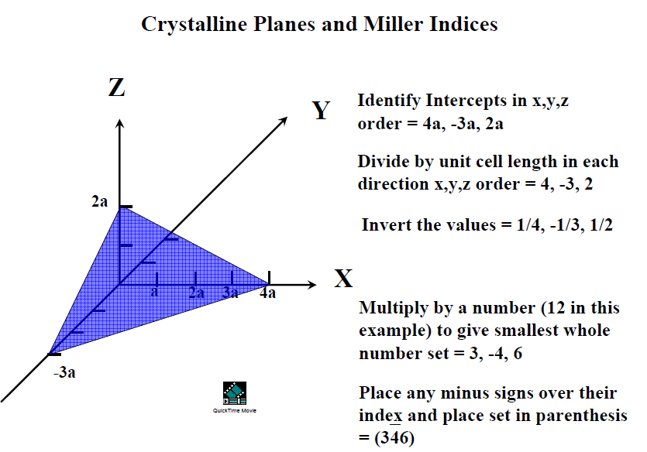

Slide 17
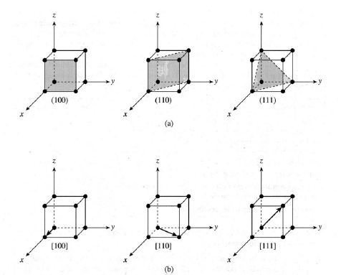
Crystalline Planes
Direction Vectors

Slide 18
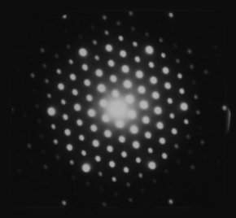
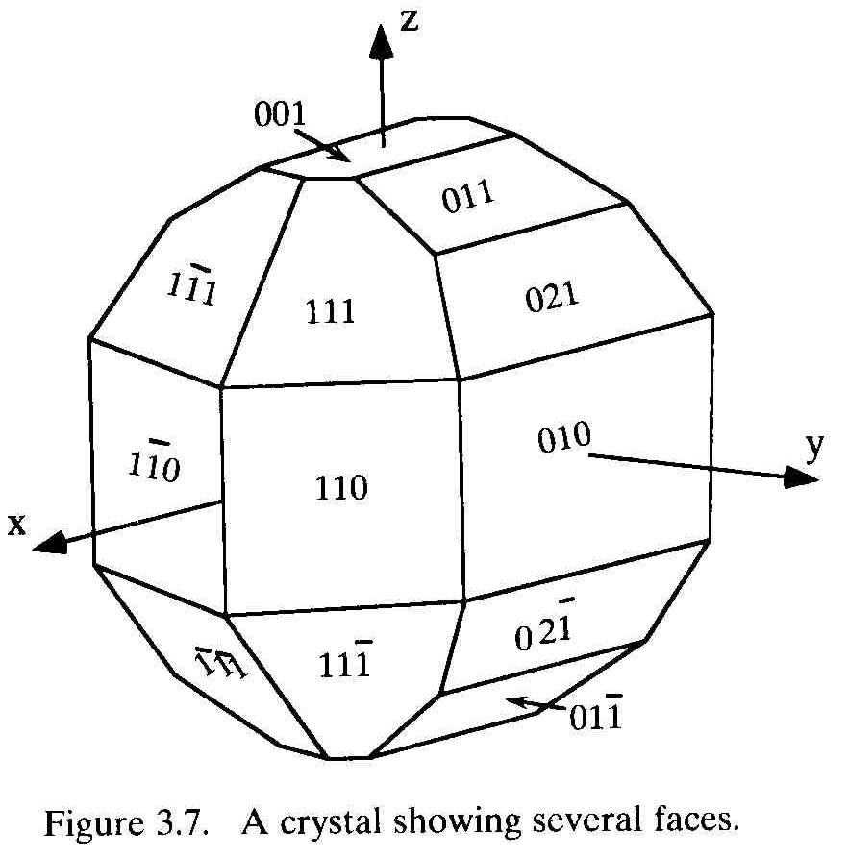
Where does a protein crystallographer see the Miller indices?
Common crystal faces are parallel to lattice planes
Each diffraction spot can be regarded as a X-ray beam reflected from a lattice plane, and therefore has a unique Miller index.
203.199.213.48/834/1/Structuresofsolids.ppt

Slide 19
How many different lattice types exist for crystalline material?
There are four types of lattices:
1) Primitive cubic
2) Body centered cubic
3) Face centered cubic
4) C-centered cubic

Slide 20




LATTICE TYPES
Primitive ( P )
Body Centered ( I )
Face Centered ( F )
C-Centered (C )
203.199.213.48/834/1/Structuresofsolids.ppt

Slide 21
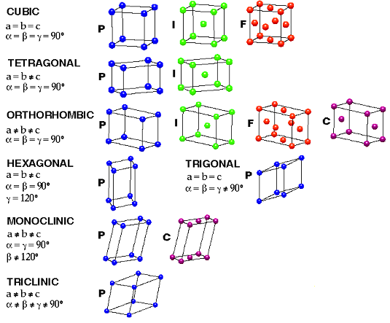
BRAVAIS LATTICES
203.199.213.48/834/1/Structuresofsolids.ppt

Slide 22
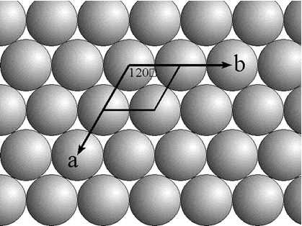
Close Packing of Spheres
The description of the ordering of atoms in a solid comes from simple concepts of how identical objects stack in an array. If atoms are round and they pack as close as possible, they should look like this:
The close packing of spheres in a plane leads to a repeat unit (parallelpiped) that has each edge equal in length to the diameter (twice the radius) of the spheres. The angles, edge length, and atomic positions of the repeat unit are sufficient for the visualization of the entire infinite array in the solid.
http://www.chem.ufl.edu/~itl/2045/lectures/lec_h.html

Slide 23
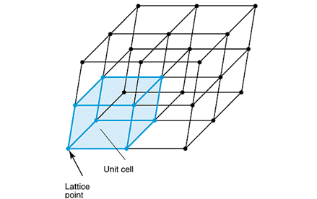
In three dimensions the repeat unit is a 3D shape called the Unit Cell. The unit cell has three uniques crystallographic axies and, in general, three edge lengths. The angles of the edges of the unit cell need not be 90 or 120 degrees. (The figure below shows a possible crystal structure and its unit cell, but it is not a closest-packed structure, like the 2D structure above)

Slide 24
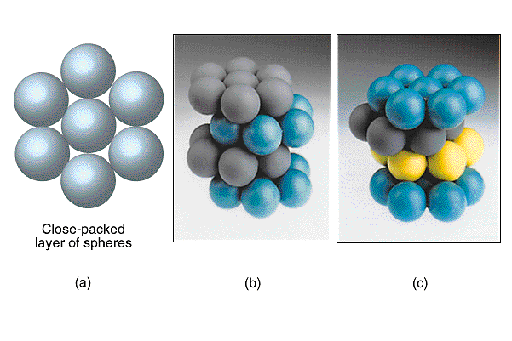
Close packed spheres of the same size in 3D is a little complicated. This packing leads to possibility of two unique structures, depending on how planes of 2D closest packed spheres are layered. If every other layer is exactly the same then we has a so called ABABA... structure. If not, then the structure is ABCABCABC...The figures below shows the difference between these two structures

Slide 25
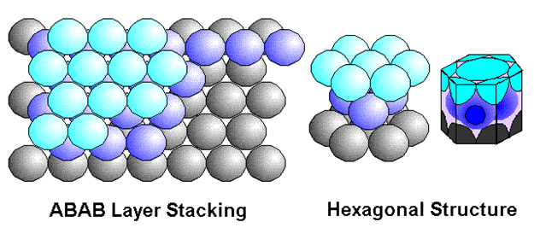
The ABABAB structure (panel (b) in the figures above) is called the Hexagonal Closest Packed (hcp) structure. In this structure, each atom has 12 nearest neighbors and the volume of the spheres fills the maximum possible space: 74.04%.

Slide 26
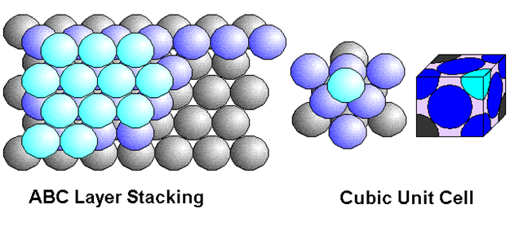
The ABCABC structure is called Face Centered Cubic (fcc). It also has each atom with 12 nearest neighbors and the atoms fill 74.04% of the available space. The difference in the structure is in the different long ranged order and the unit cell.
203.199.213.48/834/1/Structuresofsolids.ppt

Slide 27
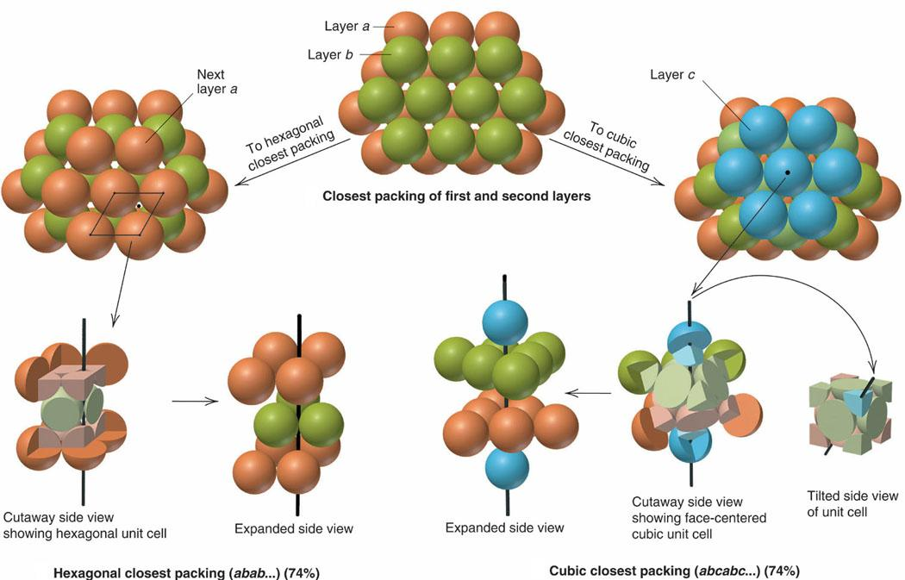
Let us examine the difference between Closed-cubic Packing and Hexagonal-Cubic Packing:
203.199.213.48/834/1/Structuresofsolids.ppt

Slide 28
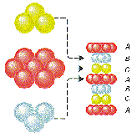
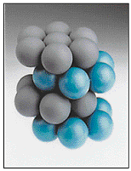
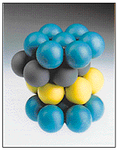
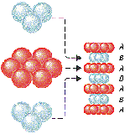
Hexagonal close packing
Cubic close packing
203.199.213.48/834/1/Structuresofsolids.ppt

Slide 29
The (fcc) structure is just one of the structures that is derived from a cubic unit cell (right angles, equal length edges). (If we allow the edge lengths to be different, but keep the right angles, we create the orthorhombic cells) The Cubic cells are shown below:
Let us watch this movie!!!!
http://www.chem.ufl.edu/~itl/2045/lectures/lec_h.html

Slide 30
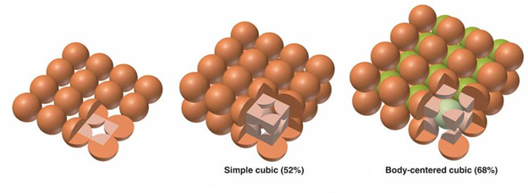
The number of atoms in the unit cell is not the same as the coordination number (number of nearest neighbors). In the Body Centered Cubic (bcc) structure above the number of atoms in the unit cell is 2 but the number of nearest neightbors is 8. (The number of gray atoms in the above gives the number of atoms in the unit cell) The (bcc) structure is not as tightly packed as the (hcp) or (fcc) structures, with the atoms occupying only 68.02% of the available space.
http://www.chem.ufl.edu/~itl/2045/lectures/lec_h.html

Slide 31
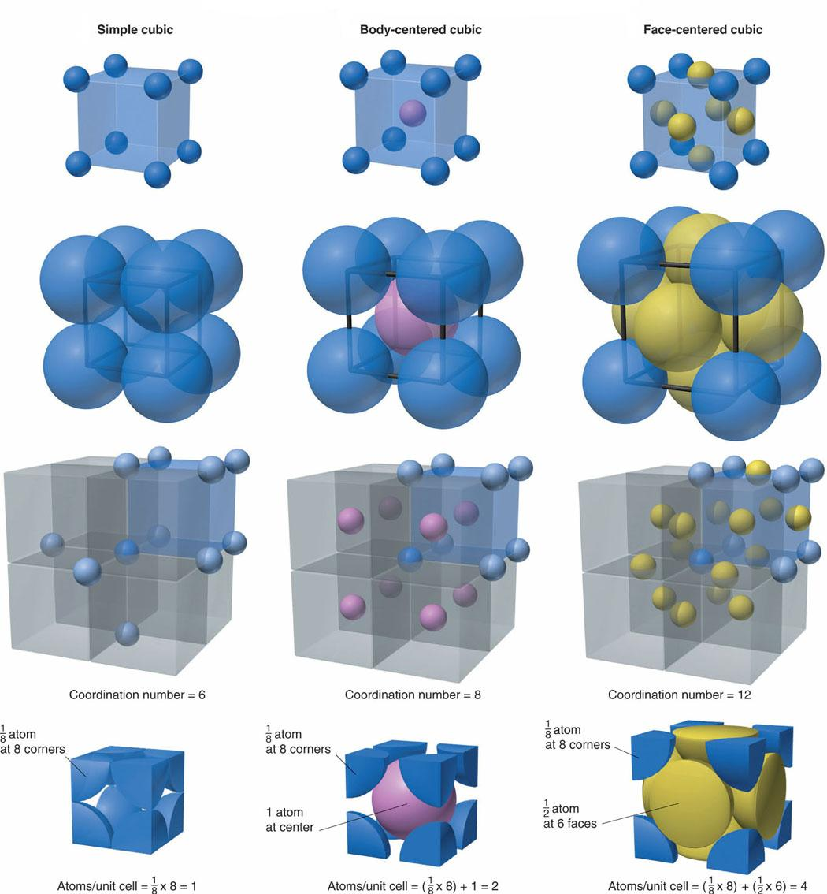

Slide 32
Structure
Coordination number
Stacking pattern
Primitive Cubic
6
AAAAA…
Non-close packing
Body-centered Cubic
8
ABABAB…
Hexagonal close packed
12
ABABAB…
Close packing
Cubic close packed
12
ABCABC…
203.199.213.48/834/1/Structuresofsolids.ppt

Slide 33
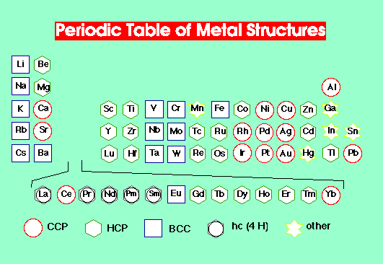

Slide 34
Until now, we have 'packed' only one kind of atom, which is only relevant for the solids states of the elements. If we wish to describe more complicated solids, i.e. solids that contain more than one atom, we must 'locate' each atom in the solid. Salts are fairly easy to describe, but some molecular solids are quite complex because of all of the different kinds of unique atoms…….

Slide 35
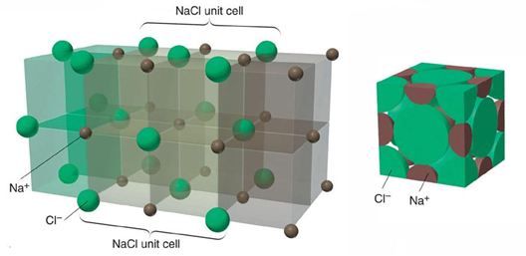
The NaCl crystal is face centered cubic (fcc) unit cell with the counter ion filling the octahedral holes in the structure. It does not matter which ion is taken to be at the verticies of the cell and which in the holes, the same pattern is obtained, as can be seen in the figure below:
http://www.chem.ufl.edu/~itl/2045/lectures/lec_h.html

Slide 36
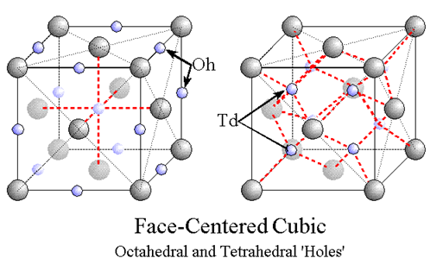
In the face centered cubic (fcc) cell there is more than one type of 'hole'.
If the octahedral holes are filled, the structure above results, with a one:one count for the two types of ions in the salt.
If the terahedral holes are filled, a diffrerent structure exists, that with twice as many of one type of ion as the other. In the figure below, The left shows the structure of NaCl and the right that of CaF2.

Slide 37
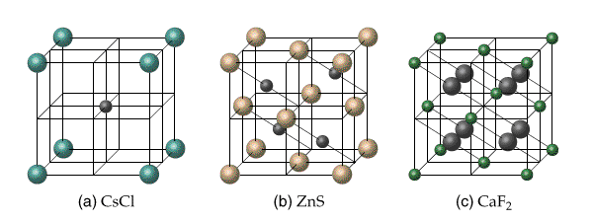
Some salts want to use the tetrahedral holes because of the relative sizes of the positive and negative ions, but don't fill all of them to maintain stoichiometry; This is the case for ZnS, the first panel below. Other relative ion sizes, like CsCl, second panel below, are filled simple cubic cells (not fcc).

Slide 38
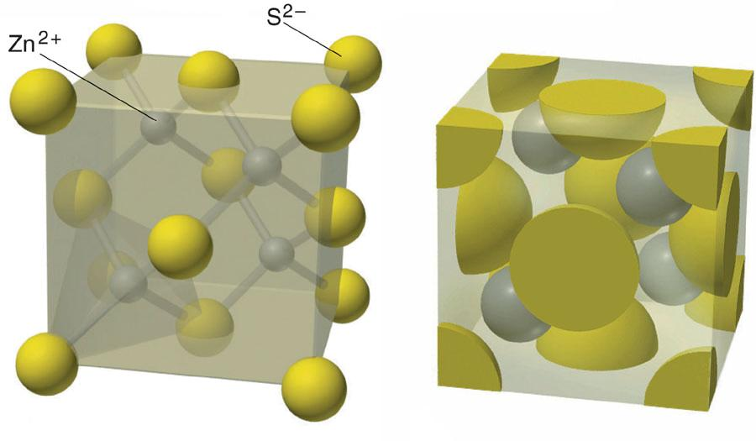

Slide 39
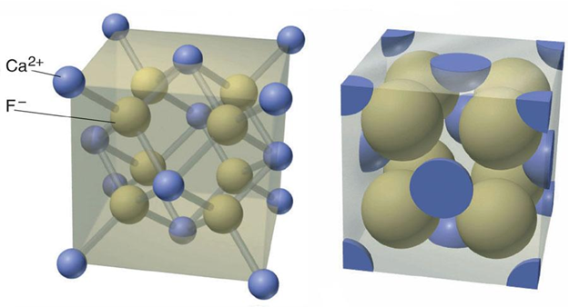

Slide 40
Diffraction occurs when light is scattered by a periodic array with long-range order, producing constructive interference at specific angles.
The electrons in an atom coherently scatter light.
We can regard each atom as a coherent point scatterer
The strength with which an atom scatters light is proportional to the number of electrons around the atom.
The atoms in a crystal are arranged in a periodic array and thus can diffract light.
The wavelength of X rays are similar to the distance between atoms.
The scattering of X-rays from atoms produces a diffraction pattern, which contains information about the atomic arrangement within the crystal
Amorphous materials like glass do not have a periodic array with long-range order, so they do not produce a diffraction pattern

Slide 41
The figure below compares the X-ray diffraction patterns from 3 different forms of SiO₂
These three phases of SiO₂ are chemically identical
Quartz and cristobalite have two different crystal structures
The Si and O atoms are arranged differently, but both have structures with long-range atomic order
The difference in their crystal structure is reflected in their different diffraction patterns
The amorphous glass does not have long-range atomic order and therefore produces only broad scattering peaks

Slide 42
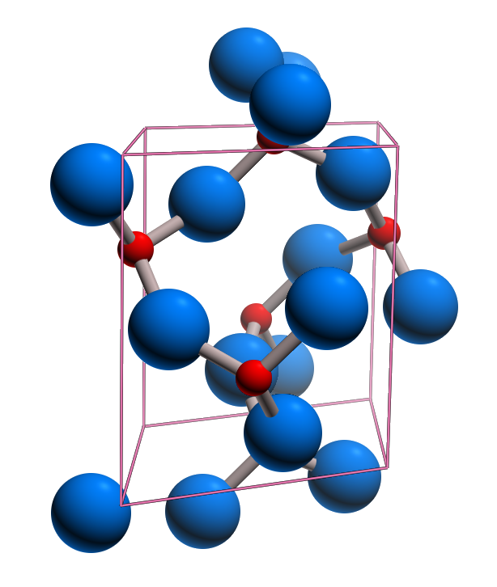
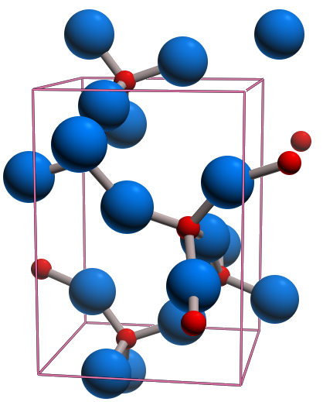
The diffraction pattern is a product of the unique crystal structure of a material
Quartz
Cristobalite
The crystal structure describes the atomic arrangement of a material.
When the atoms are arranged differently, a different diffraction pattern is produced (ie quartz vs cristobalite)

Slide 43
Diffraction peaks are associated with planes of atoms
Miller indices (hkl) are used to identify different planes of atoms
Observed diffraction peaks can be related to planes of atoms to assist in analyzing the atomic structure and microstructure of a sample

Slide 44
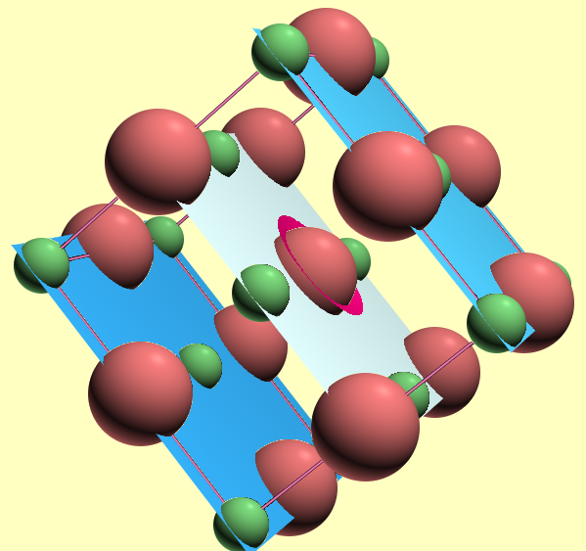
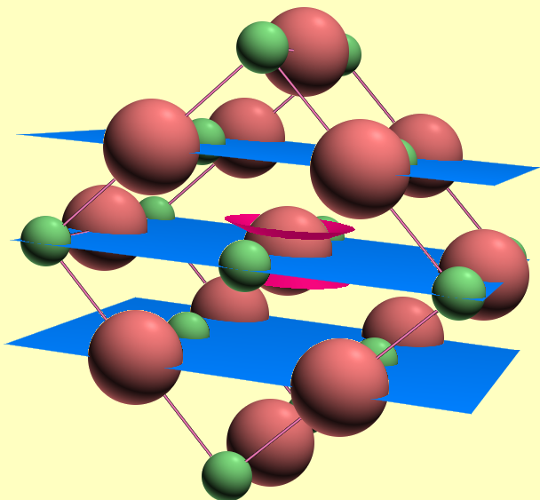
Parallel planes of atoms intersecting the unit cell define directions and distances in the crystal.
The (200) planes of atoms in NaCl
The (220) planes of atoms in NaCl
The Miller indices (hkl) define the reciprocal of the axial intercepts
The crystallographic direction, [hkl], is the vector normal to (hkl)
d_{hkl} is the vector extending from the origin to the plane (hkl) and is normal to (hkl)
The vector d_{hkl} is used in Bragg’s law to determine where diffraction peaks will be observed
http://www.google.com/url?sa=t&rct=j&q=&esrc=s&frm=1&source=web&cd=4&sqi=2&ved=0CDcQFjAD&url=http%3A%2F%2Fprism.mit.edu%2Fxray%2FBasics%2520of%2520XRay%2520Powder%2520Diffraction.pptx&ei=ZmpaUIXQHYi10AG89IFg&usg=AFQjCNFO1d1X0r4MEIBE86TvgvIFah9J5g

Slide 45
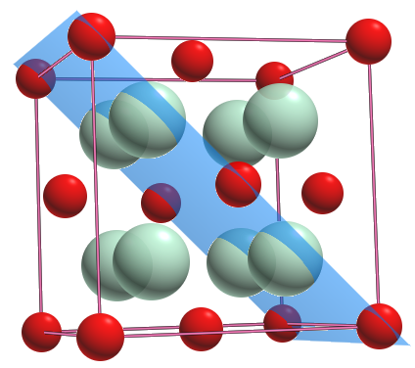
The position of the diffraction peaks are determined by the distance between parallel planes of atoms.
Bragg’s Law
d₁₁₀
Bragg’s law calculates the angle where constructive interference from X-rays scattered by parallel planes of atoms will produce a diffraction peak.
In most diffractometers, the X-ray wavelength l is fixed.
Consequently, a family of planes produces a diffraction peak only at a specific angle 2θ.
d_{hkl} is the vector drawn from the origin of the unit cell to intersect the crystallographic plane (hkl) at a 90° angle.
d_{hkl}, the vector magnitude, is the distance between parallel planes of atoms in the family (hkl)
d_{hkl} is a geometric function of the size and shape of the unit cell

